Slide 2
Notes:
Life in the ANE was hard. You had a few of these guys, on the left, priests and rulers, and they were supported by a ton of these guys on the right, who kept the flocks, and who grew the food. And how could you get those things to happen? The god did it for you! If you wanted fertility in your fields and flocks and family, the god was the one who got the job done.

Slide 3
Gods in the Ancient Near East
Asherah
Ba’al
Moloch
Ashur
Marduk
Dagon
Ra
Notes:
There were tons of gods in the ANE; we should recognize these names if we’ve read the OT. The major gods in Canaan were Asherah and Ba’al.

Slide 4
Marduk
Ra
Ashur
Dagon
Asherah
Ba’al
Thor
Notes:
Gods in this period represented traits. Most of the really powerful ones were sun gods. Many more (like Asherah and Ba’al were fertility gods. But they did double and triple (and more) duty. Ba’al was also the storm god, just like Thor was in the Norse pantheon.

Slide 5
Gods in the First Century
Isis
Family/household
deities
Celts:
Rosmerta
Lugh
Belonos
Mithras
Imperial cult
Egyptians:
Ra
Osiris
Horus
Jews:
YHWH
Notes:
And of course, in the first century, there were many gods, and they worked the same way: there was a pantheon, representing different things. We’re familiar with the Greek pantheon that the Romans adopted. In addition to those were the family and household gods, the Imperial cult. Different peoples had different pantheons. And then, of course, were those curious Jews with their strange insistence that there was only one god, and it was theirs.

Slide 6
+
=
Notes:
Regardless, though, across the ancient world, it worked like this: you have your god, the one who does the thing you want or need, and if you do the right rituals and sacrifices in the right way, then the god would do what you wanted.

Slide 7
god
Notes:
Want those bad storms to go away and the sun to come out? There’s a god for that! Going out on the scary, unpredictable ocean? There’s a god for that. Want to have fertility in your fields and flocks and family? There’s a god for that!

Slide 8
Notes:
Even the Israelites got in on the game. “Whoa, Moses has been up there on that mountain for, like, a LONG time. Tell you what: lets take our gold and make a god we can worship.”

Slide 9
“They gave me the gold, and I threw it into the fire, and out came this calf!”
Notes:
Of course, though; idol worshipping makes YHWH super duper angry.
When Moses confront Aaron, he was super pissed, leading Aaron to utter the stupidest thing said in the entire bible: “They gave me the gold, and I threw it into the fire, and out came this calf!”

Slide 10
“YHWH your god shall give you an extra measure for the good in all your handiwork: in the fruit of your womb, and the fruit of your beasts and the fruit of your soil” (Dt 30.9).
Notes:
And why on earth wouldn’t it? He is the creator, and no other. He is the one who covenanted with the Patriarchs. He is the one who rescued Israel. He is the one responsible for blessing, and no other. He is our safety. He and he alone is our hope.
And when humans engage in idolatry, they turn from that…

Slide 11
Notes:
…to this.

Slide 12
Notes:
There are still places in the world where literal idolatry is practiced. Not here in the west, of course. No, sirree. No, we’re good monotheists, and we’d never worship another god, no way, no how.

Slide 13
Notes:
But this brings me back to Asherah. Let me tell you how I became a worshipper of Asherah.

Slide 14
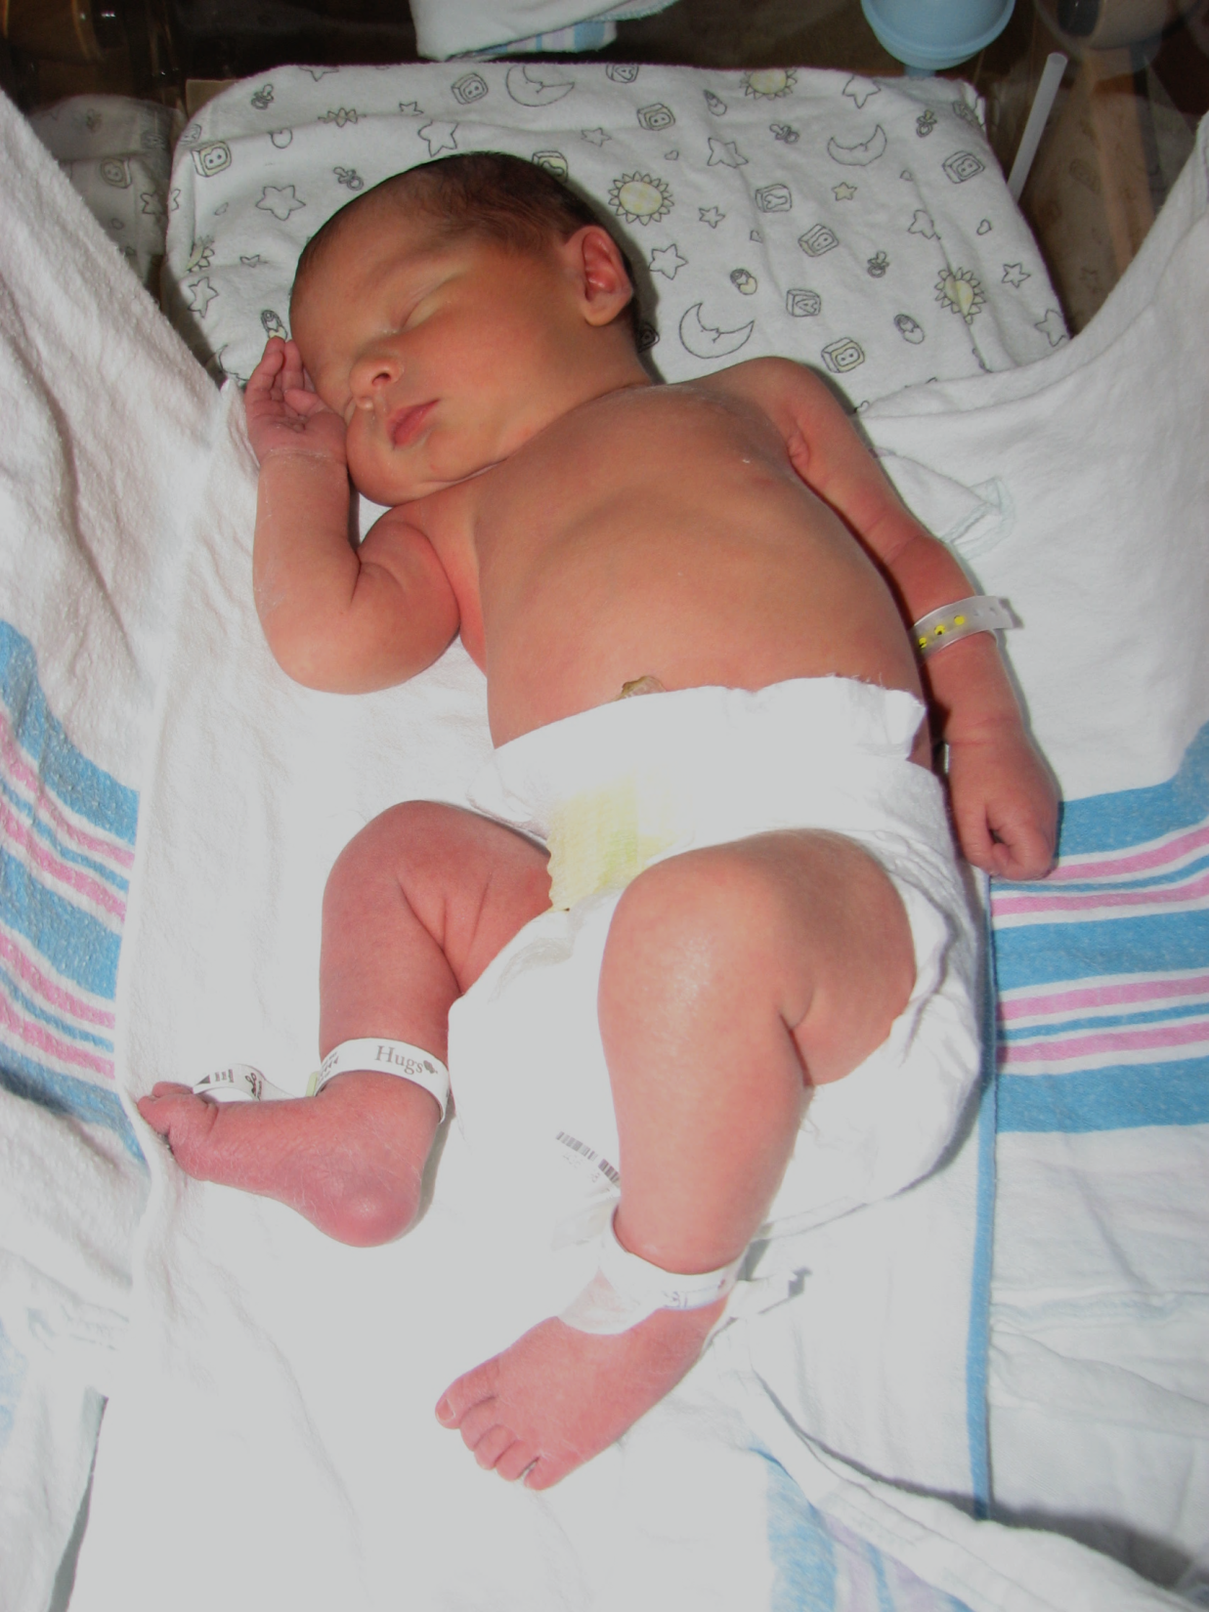
Notes:
This is my son Levi. Born 4 weeks premature via c-section. We loved him like crazy, but we also wanted more kids.

Slide 15
Notes:
This is my son Aaron. He was born 14 weeks early, via a different kind of c-section. What you see there? That’s my wedding ring. It was a long road to get him home, and we loved him like crazy, but we still wanted more kids.

Slide 16
Notes:
But when Annie talked to her doctor, she said it would be too risky. So we decided to be done, and took steps to make that happen.

Slide 17
Notes:
But what I didn’t know, not really? I still wanted more kids.

Slide 18
Notes:
Fast forward 6 years, and Randy asks if we’d be willing to host Titus’ girlfriend over the summer. ”Of course! That’s why we got the house in the first place!”

Slide 19
Notes:
And at the beginning of the summer, that’s how it was: Titus’ girlfriend.

Slide 20
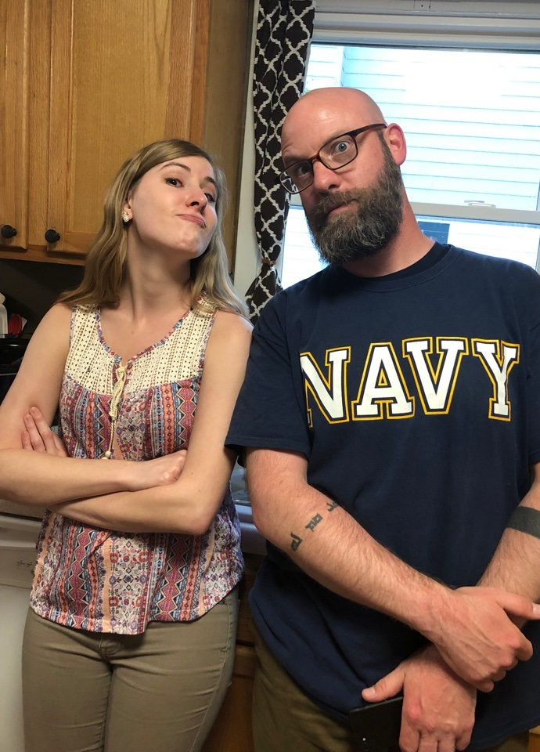
Notes:
But from minute one, she just became part of my family. Not fake part, not honorary part. Part of the family. Then it wasn’t, “Yay, we get to host Titus’ girlfriend!” it was more, “Listen, Titus; if you hurt her, I will punch you in the nose.”

Slide 21
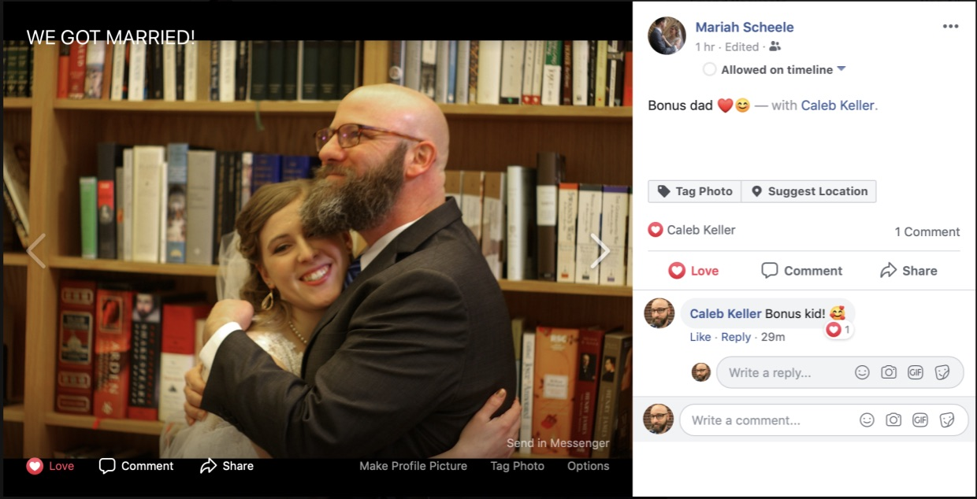
Notes:
So when she got married, and bonus kid moved out of bonus dad’s house, all of the sudden, I’m feeling like the house just got emptied out a little.

Slide 22
Notes:
And in that zone, two ideas came together in a way they never had before: “I want more kids,” and “I’m not going to have any more kids.”

Slide 23
Notes:
It hurt. It really, really hurt. But as I grappled with the issue, I came to two basic beliefs about it: (1) it is OK to want to have more children, and (2) it is OK to be sad that you can’t have any more children.

Slide 24
Notes:
And that’s when Satan started to take that truth, and distort it:
Yes, it’s OK to be sad; in fact, it’s OK to be really, really sad
In fact, you should probably have a seat and explore that sadness. Really feel it, you know?
In fact, it’s OK if you need to just sink in and wallow for awhile.
(And here’s the crucial turn) After all, if you had more children, you’d be happy

Slide 25
Notes:
Whoa—hold up there. Can’t be happy?

Slide 26
Notes:
The problem was that all of this was happening subconsciously.

Slide 27
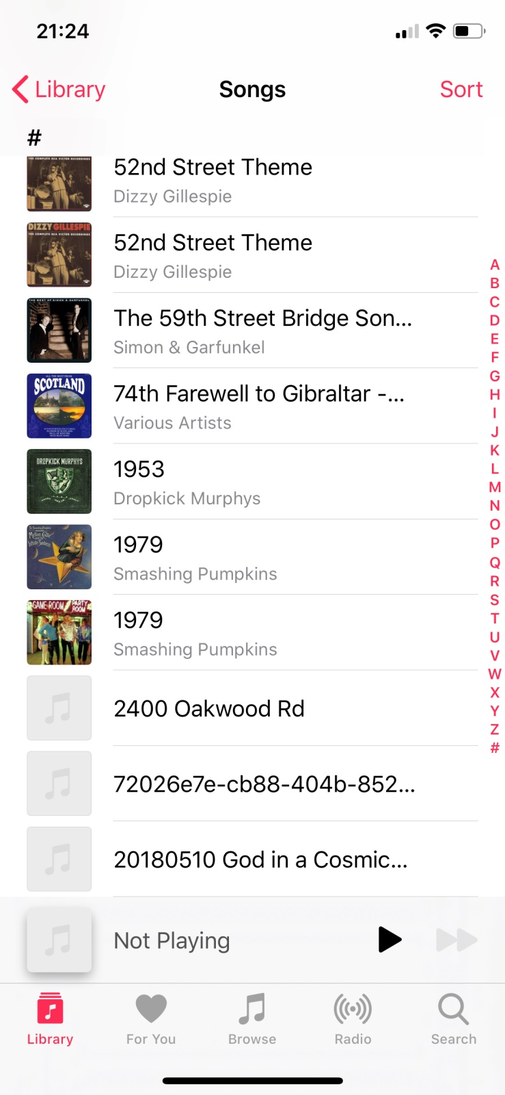

Slide 28
+
=
Notes:
“But Caleb, you said that idols work like this: you have the god of the thing, and if you do your sacrifices right, everything will be OK.” But you’re not sacrificing.
Well, true. I wasn’t sacrificing a bull or anything.

Slide 30
Notes:
And the worst part of it is this: it kept me from realizing that God had already answered my prayers—just not the way I expected (and isn’t that just like our God??).
See, I’m in this weird new phase of life where there are adult humans who could plausibly be my children. Elijah Bouman’s dad is my age. Heck, Luke Riffo’s dad is younger than me!
And for some of these people, I get to be bonus dad.

Slide 31
“You shall utterly destroy all the places where the nations whom you are to dispossess worshipped their gods—on the high mountains and in the valleys and under every lush tree. And you shall smash their altars and shatter their sacred pillars, and their Asherah poles you shall burn in fire, and the images of their gods you shall chop down, and you shall destroy their name from that place” (Dt 12.2-3).
Notes:
But this brings me back to Asherah. My worship of Asherah, the personified idea of fertility, kept me from accepting what God has given me, and investing in that. And isn’t that just like Satan?
Yet God’s desire is for us to root out every appearing of idolatry.

Slide 33
=
?
A thing within the created order that takes God’s place.

Slide 34
Gives us safety/security
Secures our success/happiness
Gives us hope for the future
Receives our unswerving devotion
Is something we sacrifice for/to

Slide 35
Not bad things!

Slide 37
=
?
A thing within the created order that takes God’s place.

Slide 38
What are some of the effects of idolatry?
How have you seen idolatry in action?
Gut check: what are your idols? Or, how are you tempted to idolatry?
Gut check: how’s the contemporary, Western church doing with idolatry?

